Slide 1

CMR COLLEGE OF ENGINEERING & TECHNOLOGY
Kandlakoya, Medchal, Hyderabad - 501401
Department of Computer Science and Engineering
PREDICTING DIABETES IN PREGNANT WOMAN AND NEONATAL MELLITUS IN NEW BORN CHILD USING MACHINE LEARNING
Name of the student
G. Mahendra (21H55A0504)
H. Laxman (21H55A0508)
M. Jyoshna (21H55A0513)
Under esteemed guidance of
Mr. J. Ranjith (Assistant Professor)
Batch: 2020-2024
Major Project Phase 2

Slide 2
Outline
Abstract
Introduction
Literature survey
Existing system
- Problems in existing system
Research Objective of Presentation
Problem Definition
Research work
- Proposed system architecture
- Methods
- Comparison of Proposed system with an existing system
Performance Measure
Results
Conclusion
Future Work
References
Notes:
2

Slide 3
ABSTRACT
Machine learning is a crucial technique for estimating the probability of such a development based on the provided data, as gestational diabetes might advance to permanent diabetes. Pregnancy-related diabetes may be predicted by the current study, but neonatal diabetes risk cannot be predicted. Therefore, in order to deliver the most precise results about diabetes persistence in pregnant women and to enhance the forecasting of neonatal mellitus, new characteristics are needed. This may be accomplished with the use of Python scripting and machine learning techniques like K Nearest Neighbors, Support Vector Machines, and Logistic Regression. The preprocessed machine learning dataset on diabetes was gathered via Kaggle and came from the Pima Indian diabetes database. Additionally, the project's dataset now includes two additional attributes. Research suggests that machine learning models using features like SVM and decision trees may be able to accurately predict a pregnant woman's probability of developing diabetes.

Slide 4
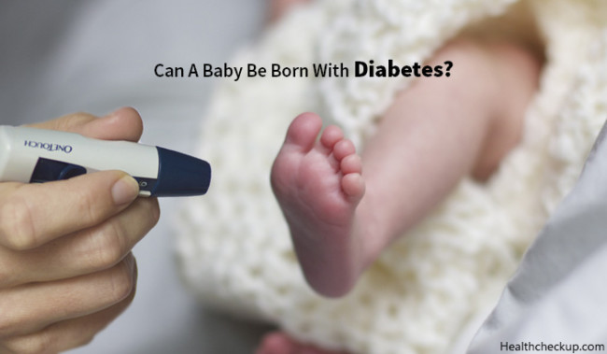
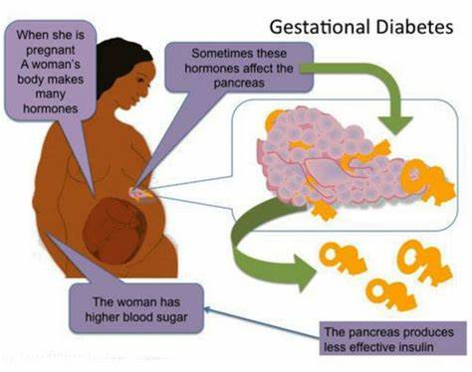


Slide 5
Introduction
A long-term metabolic disease characterized by high blood glucose levels is called diabetes mellitus. It is a serious public health concern that impacts people of all ages and is regarded as one of the most challenging diseases of the twenty-first century. Diabetes is a serious ailment that has an impact on the developing child as well as the expectant mother. Diabetes during pregnancy increases the risk of complications such as premature labor, cesarean delivery, and infant morbidity and death.
Predicting diabetes in expectant mothers and neonatal diabetes in babies is essential for the best possible care and problem-avoidance. Machine learning has shown promise in healthcare as a diagnostic and prognostic tool for conditions like diabetes. Using information from electronic health records, clinical notes, test results, and patient demographics, machine learning algorithms may identify patients who are at risk of developing diabetes and tailor treatment plans based on particular patient features.
Notes:
5

Slide 6
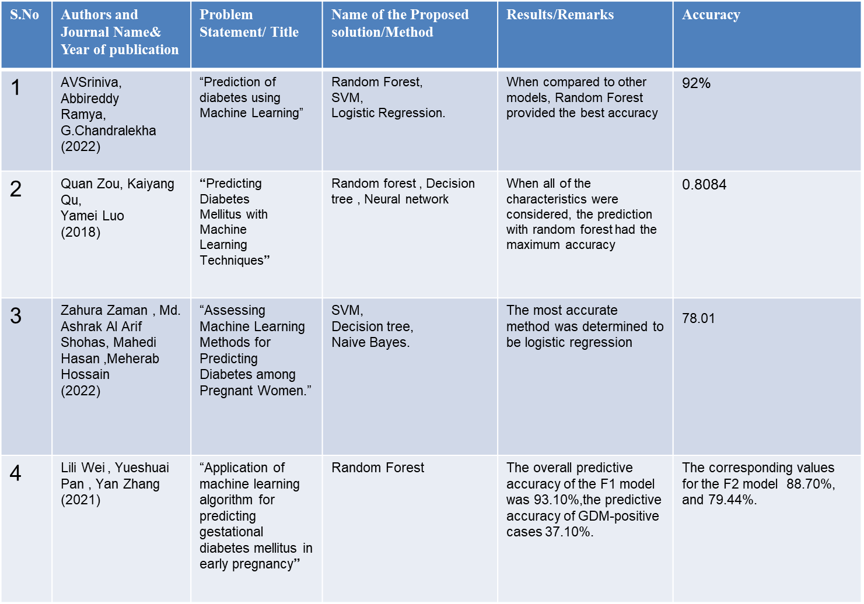
Existing system
Notes:
6

Slide 7
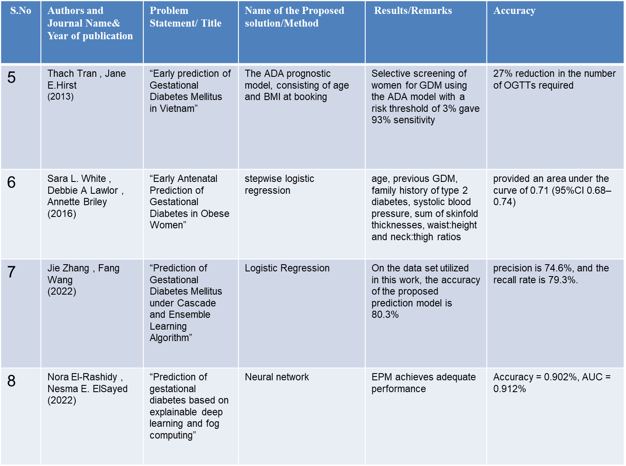

Slide 8
Research objective
The study contributes to the growing body of research on the use of machine learning to diabetes prediction.
The authors assessed the effectiveness of various machine learning techniques, including logistic regression, random forests, decision trees, and support vector machines.
The results suggest that machine learning methods could be a useful tool for early GDM prediction, perhaps mitigating the illness's detrimental impact on health.

Slide 9
Problem Definition
Diabetes is a chronic condition that affects millions of individuals all over the world and can have major health, particularly during Pregnancy. Early identification and treatment of GDM are critical for avoiding negative effects for both the mother and the child.
The goal is to identify infants at higher risk of neonatal diabetes mellitus, enabling timely monitoring and intervention to mitigate potential health risks and improve long-term outcomes.

Slide 10














Proposed system architecture
Data Pre-processing
Data
Integration
Data
Cleaning
Data Transformation
Data
Reduction
Prediction
User Interface
User

Slide 11
Proposed Methods
By analyzing large datasets and identifying risk factors that conventional methods might overlook, machine learning (ML) has demonstrated promise in the prediction of GDM.
The intention is to guarantee these models dependability and practicality by training them on extensive and varied datasets.
Currently available methods for detecting GDM mostly depend on clinical risk factors and blood glucose testing.

Slide 12
Performance Measure:
The project aims to produce efficient machine learning models with an interface that is easy to use for healthcare prediction.
Accuracy: Overall correctness of the model's predictions.
Sensitivity (Recall): Ability to correctly identify positive instances (e.g., gestational diabetes or neonatal mellitus cases).
Specificity: Ability to correctly identify negative instances (e.g., absence of gestational diabetes or neonatal mellitus cases).
Precision: Accuracy of positive predictions made by the model.
AUC-ROC: Measure of the model's discrimination between positive and negative instances.

Slide 13
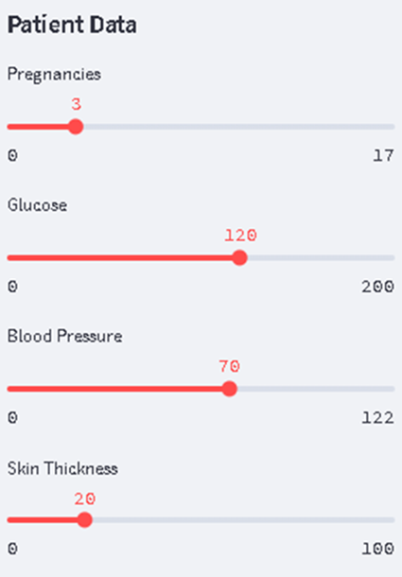
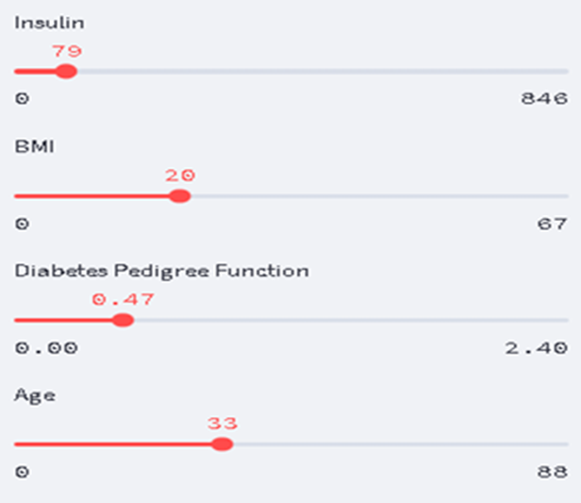
Experimental Results:
Fig: 1 & 2 Patient Details

Slide 14
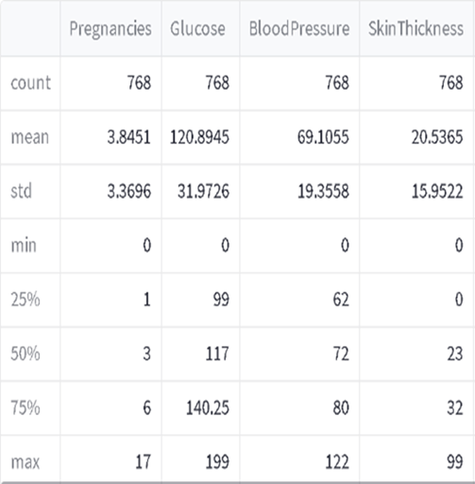
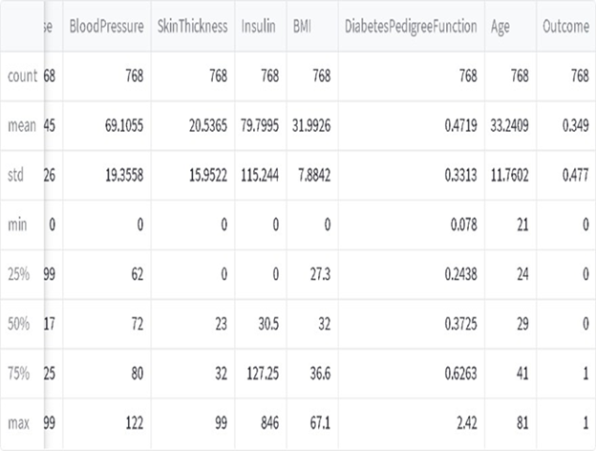

Fig: 3 & 4 Patient Details

Slide 15
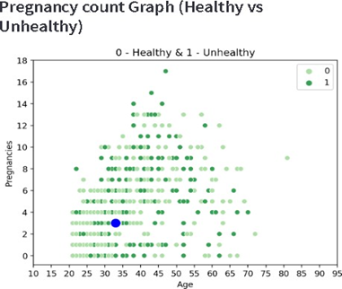
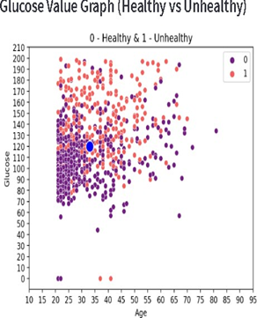
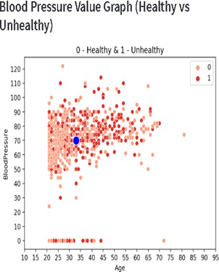
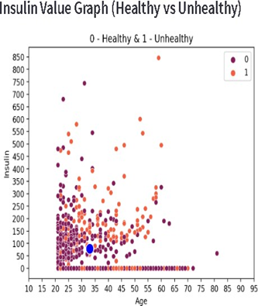
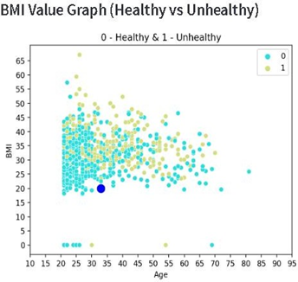
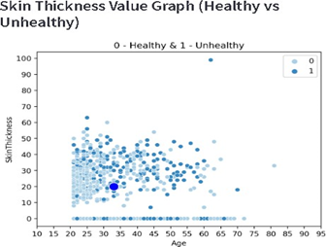
Pregnancy Count Graph
Glucose Value Graph
Blood Pressure Value Graph
Skin Thickness Value Graph
BMI Value Graph
Insulin Value Graph

Slide 16
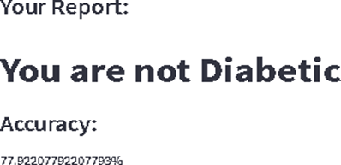
Fig: Output and Accuracy
(Expected Outcomes)

Slide 17
Result Analysis
The following outcomes were obtained from the proposed project:
Determining the accuracy score of the models that were evaluated using the dataset.
Projecting an interface to receive input from users.
Distributing graphics that show the reasons at the moment versus the person's age.
Indicating if the user is a diabetic or not.
Presenting the precision of the produced outcome.

Slide 18
Conclusion
There is a user interface in the project that lets users submit ideas. An interface may take the shape of a command-line interface, a web application, or a graphical interface.
The project proposal entails training and testing models on a dataset, offering an intuitive input interface, creating graphs to illustrate the correlation between age and causes, predicting a user's status as diabetic or not based on input, and indicating the prediction result's accuracy.

Slide 19
Future work
Machine learning have various potential future improvements that could further increase their efficency and accuracy. These are some important areas that need further work.
Real-Time Data Incorporation: Dynamic and individualized risk assessment can be made possible by including real-time data, such as continuous glucose monitoring, maternal vital signs, and fetal monitoring.
Electronic Health Record (EHR) Integration:Utilizing the vast amount of data found in electronic health records can yield a thorough patient profile for precise risk assessment.
External Validation and Generalizability: Predictive models to be externally validated on a range of patient demographics and healthcare environments.
Ethical Issues and Data Privacy: Future improvements should carefully address ethical issues and data privacy

Slide 20
References
Amarnath, S., Selvamani, M., & Varadarajan, V. (2021). Prognosis Model for Gestational Diabetes Using Machine Learning Techniques. Sensors & Materials, 33.
Yang, J., Clifton, D., Hirst, J. E., Kavvoura, F. K., Farah, G., Mackillop, L., & Lu, H. (2022). Machine learning-based risk stratification for gestational diabetes management. Sensors, 22(13), 4805.
Lai, H., Huang, H., Keshavjee, K., Guergachi, A., & Gao, X. (2019). Predictive models for diabetes mellitus using machine learning techniques. BMC endocrine disorders, 19, 1-9.
Basarab, M. R., Ivanko, K. O., & Kulkarni, V. (2021). Prediction of the Development of Gestational Diabetes Mellitus in Pregnant Women Using Machine Learning Methods.
White, S. L., Lawlor, D. A., Briley, A. L., Godfrey, K. M., Nelson, S. M., Oteng-Ntim, E., ... & UPBEAT Consortium. (2016). Early antenatal prediction of gestational diabetes in obese women: development of prediction tools for targeted intervention. PloS one, 11(12), e0167846.

Slide 21
Thank You!

